Slide 1
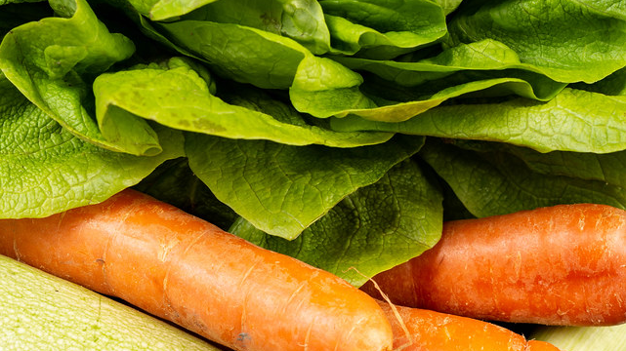
Sprouter
By: Alari Tork, Drew Yu, Jonathan Oh, and Taniya Peterratnaraj

Slide 2
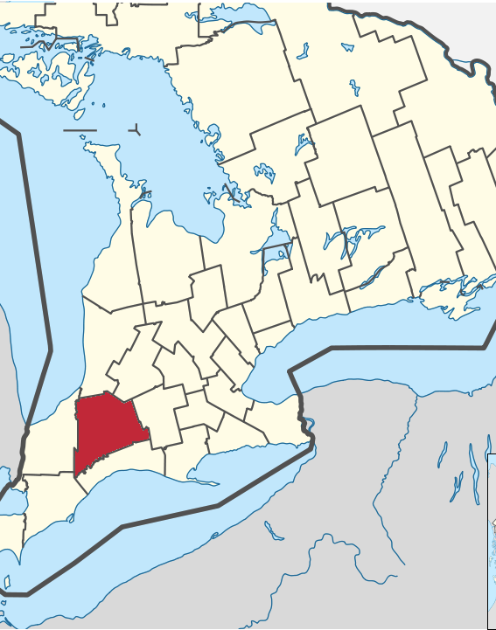
What does it do?
Extension of the ITraceFresh mobile application
Social Network for consumers and the producers of their food
Scan for info on produce, the story behind it, and the food you can make with it
Promotes a more globally and locally conscious consumer

Slide 3

Why is it important?
Reaches out to smaller communities
Encourage smaller farmers to grow a dedicated group of local buyers
Advertising for future purchases

Slide 4
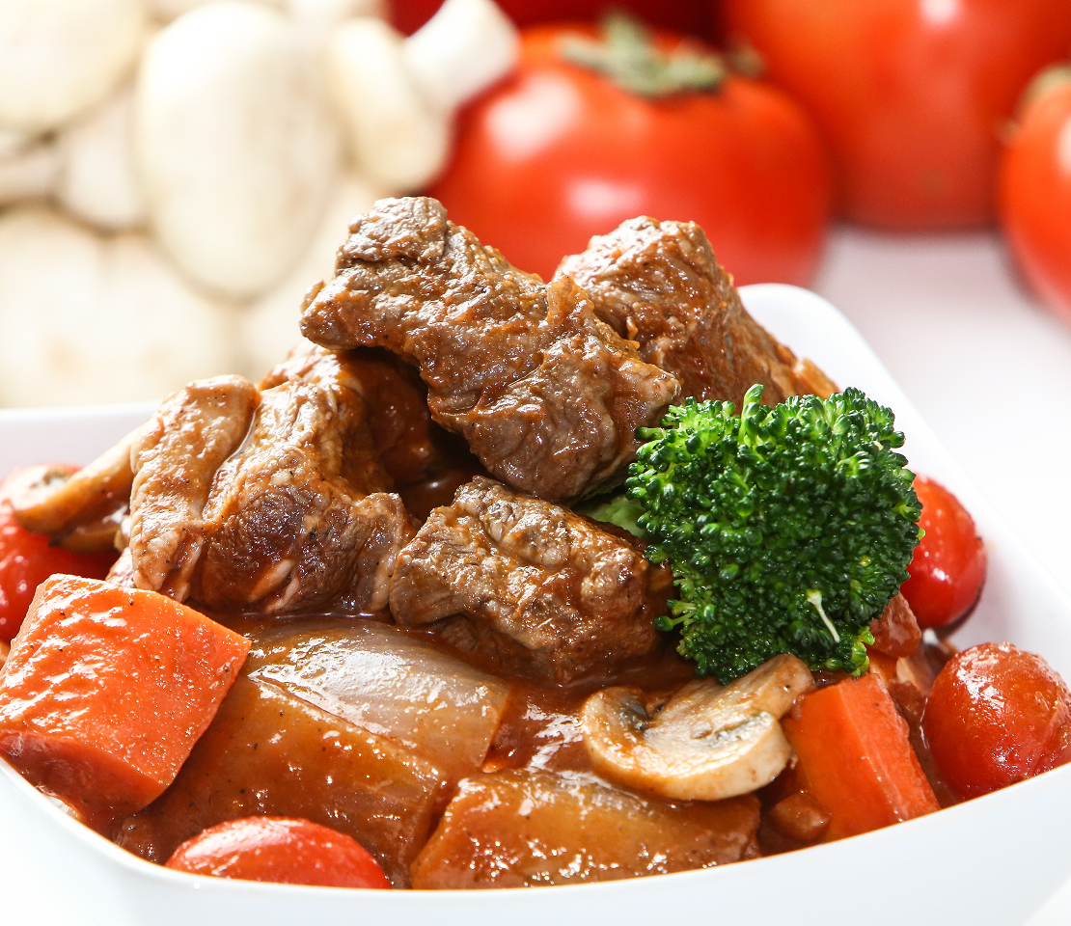
Sprouter Vs. Other forms of Advertisement?
Provides more impactful reaching advertisement and brand promotion
Memorable stories and food from the various recipes offered
Benefits the retailer, and indirectly the rest of your supply chain

Slide 5
Features
Login with your Google account, or create one with an email-address and password
Look up the local farmer your produce came from and their story
Share your experience and recipes with others
Discover new recipes from other locals and farmers

Slide 6
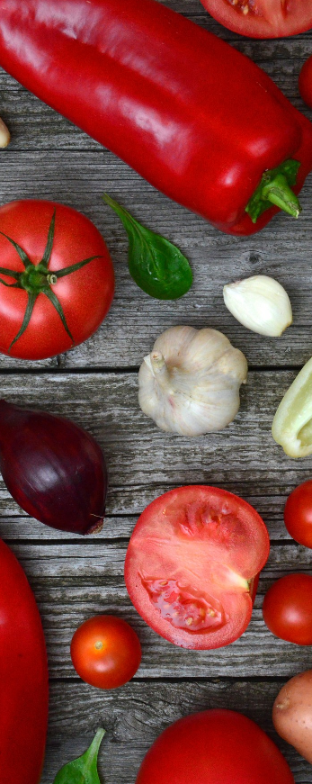
Going Forward
Initial
Initial cost from creating and advertising to raise awareness
Continual Server maintenance costs, and collecting stories and recipes
Feature
Feature popular farmers’ recipes to get more customers interested
Collect Data
Utilize data from popular recipes to assist in predictive purchasing patterns and strategically place popular recipe ingredients on sale.

